Slide 1



Since 1974, World Environment Day has been celebrated every year on 5 June, engaging governments, businesses and citizens in an effort to address pressing environmental issues.
UNIT
4 HP(I) COY NCC Hamirpur Directorate Punjab Haryana Chandigarh Himachal Pradesh
CADETS
Pakistan to host World Environment Day 2021
ASHISH KUMAR
ANKIT SAIN

Slide 2

definition
A process of reversing the degradation of ecosystems, such as landscapes, lakes and oceans to regain their ecological functionality; in other words, to improve the productivity and capacity of ecosystems to meet the needs of society.

Slide 3
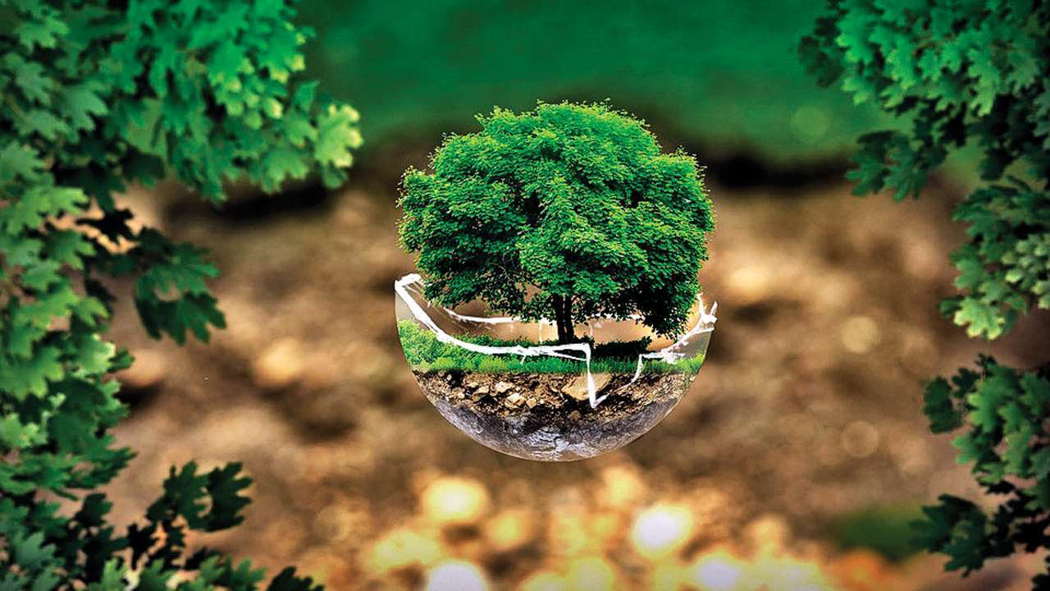
Purpose and history
P
UR
P
O
S
E
Ecological restoration aims to recreate, initiate, or accelerate the recovery of an ecosystem that has been disturbed. Disturbances are environmental changes that alter ecosystem structure and function. Common disturbances include logging, damming rivers, intense grazing, hurricanes, floods, and fires.
H
I
S
T
O
R
Y
The idea of restoring the land dates back centuries, but modern restoration ecology and its practice began in the early 1900s when people such as renowned conservationist Aldo Leopold began promoting the movement.

Slide 4
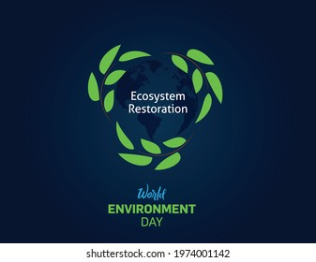
ECOSYSTEM PROPERTIES
• Resistance: To resist displacement from the initial stage
• Resilience : If ecosystem is disturbed the activity of ecosystem to recover the initial stage after disturbance
• Elasticity : The rate of recovering in the initial stage after disturbance
• Amplitude : A zone which the sys. Disturbed will return to initial stage with high speed
• Hysteresis : The extent to which the pattern of recovery differs form the path of degradation
• Malleability : The degree to which the new permanent stage establishment after disturbance differs from initial stage

Slide 5

FORMS OF ENVIRONMENTAL DEGRADATION
GLOBAL WARMING
ENERGY CONSUMPTION
DISTURBANCE
SUCCESSION
ECOSYSTEM FUNCTION
LANDSCAPE ECOLOG

Slide 6

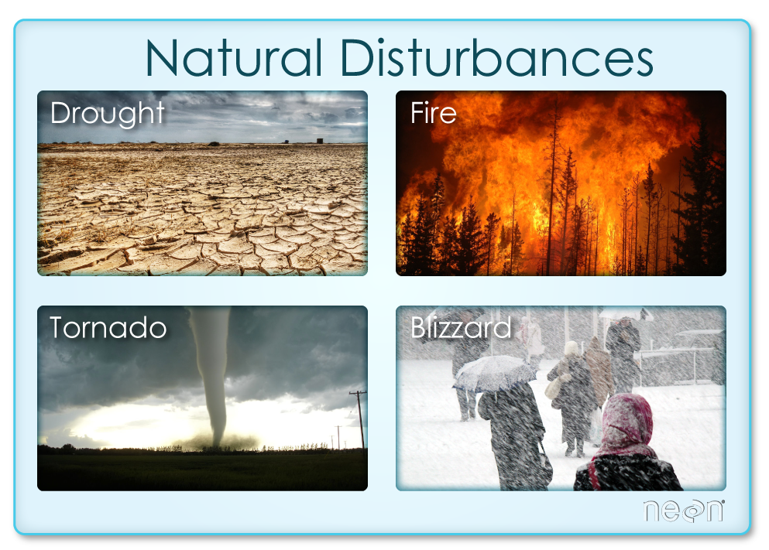
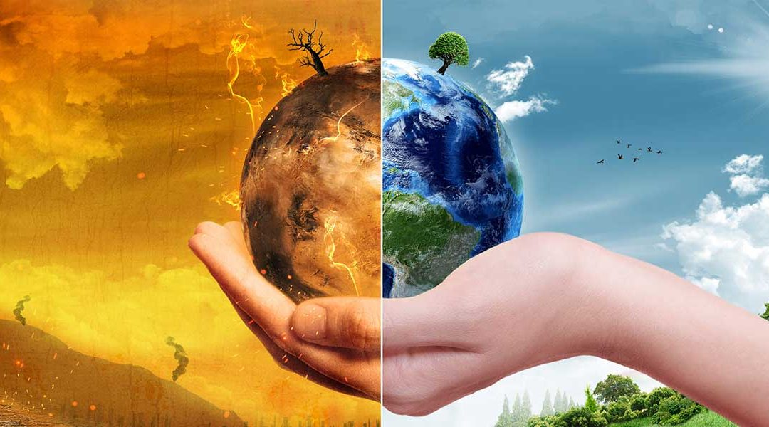
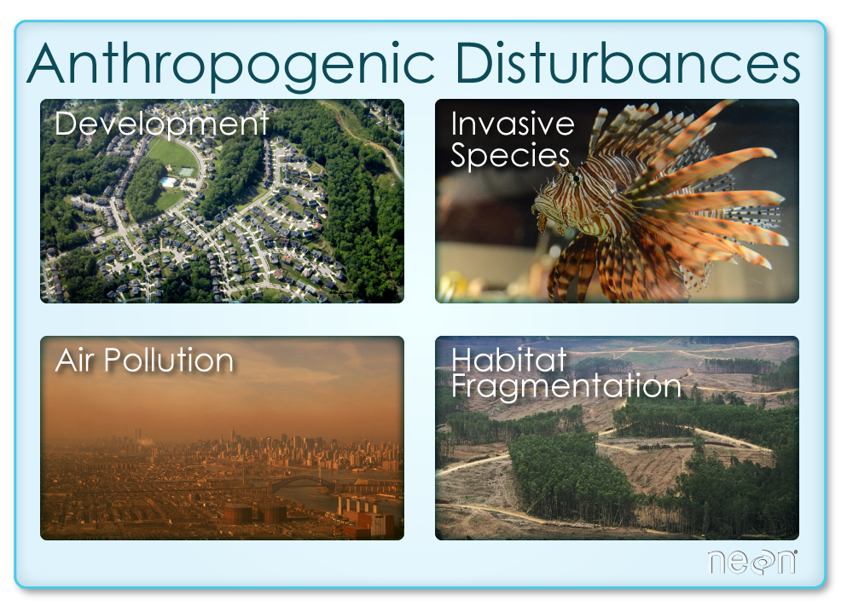

CONTINUED
GLOBAL WARMING

Slide 7
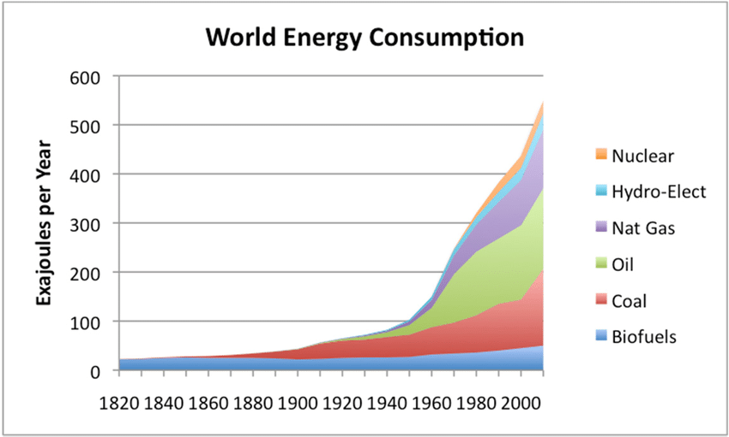
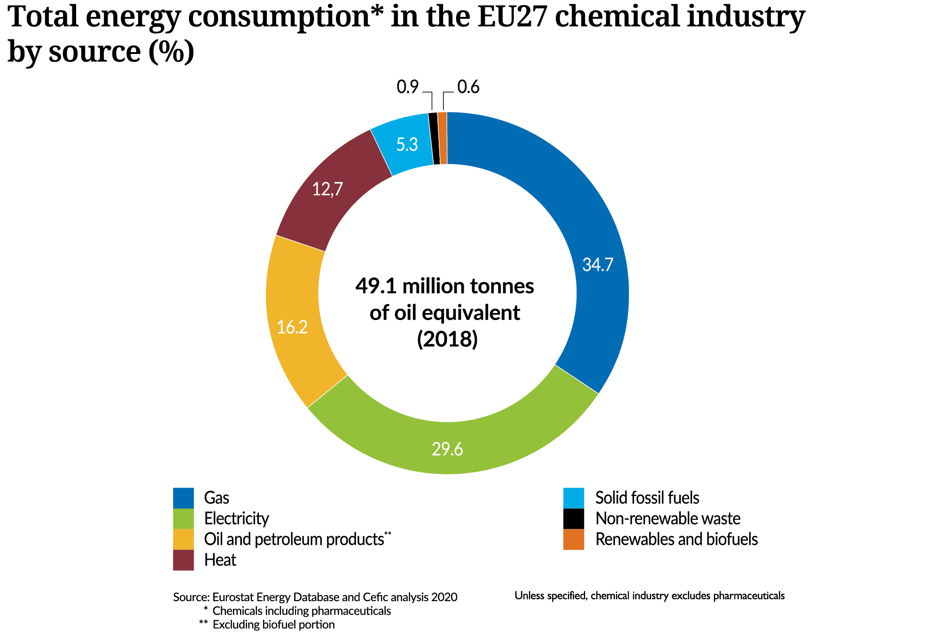
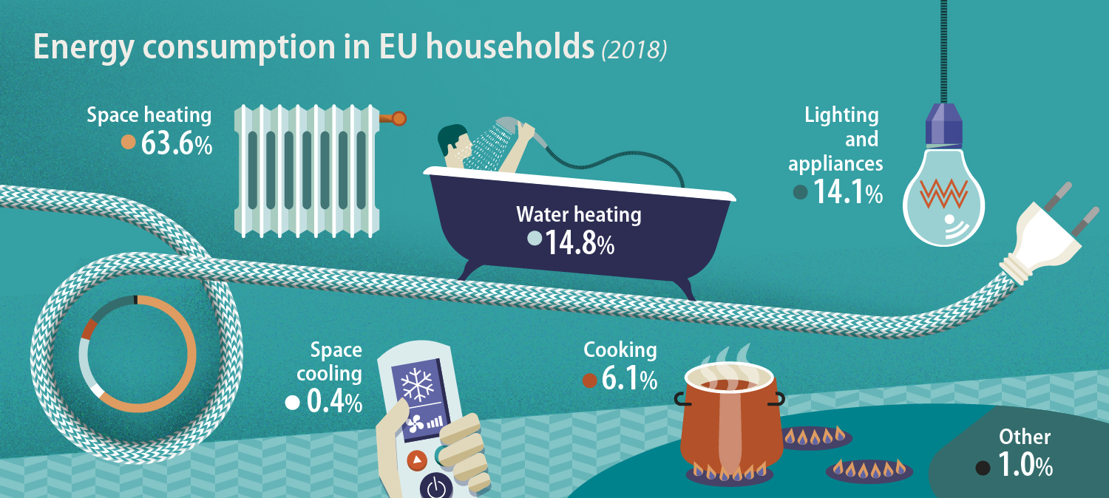
CONTINUED

Slide 8
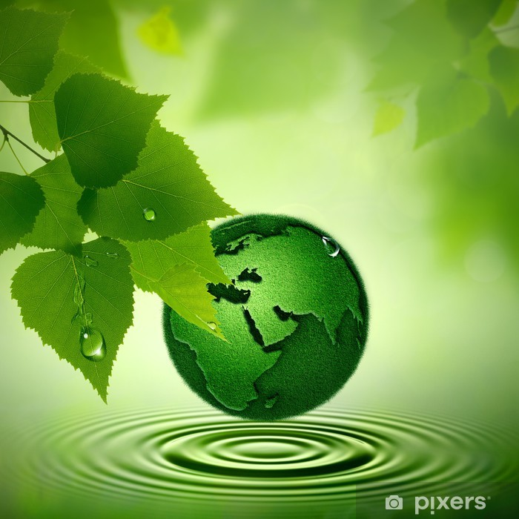
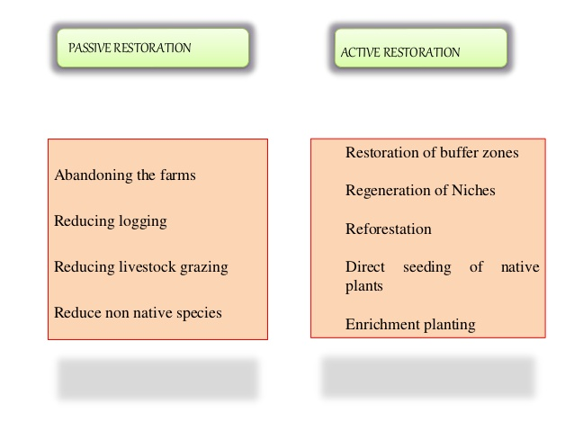
SUCCESSION
Process by which biological community composition- the number and proportion of different species in an ecosystem- recover over time following a disturbance event.

Slide 9
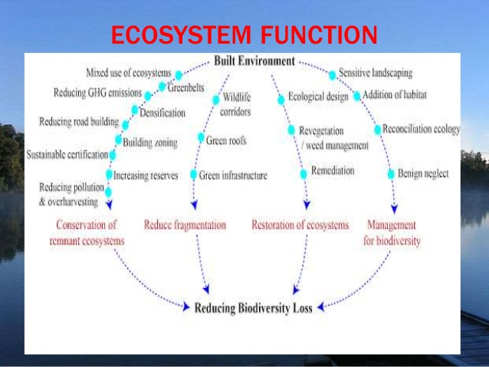
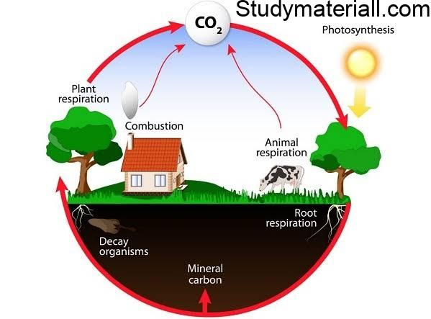

Slide 10
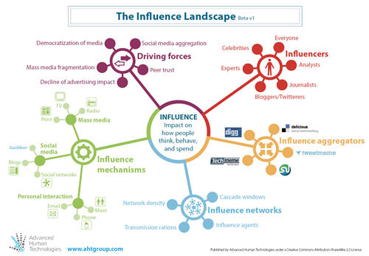
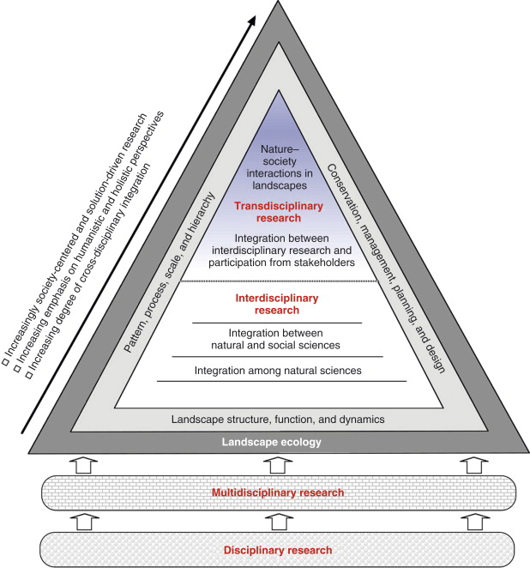

Slide 11
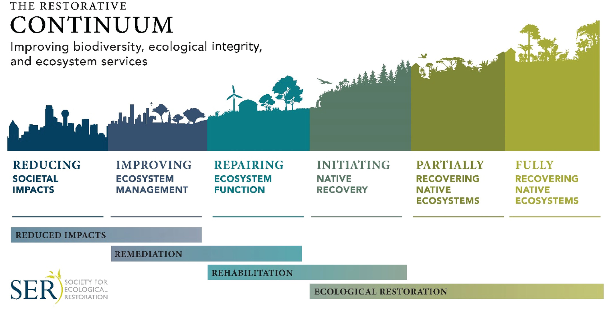

Slide 12

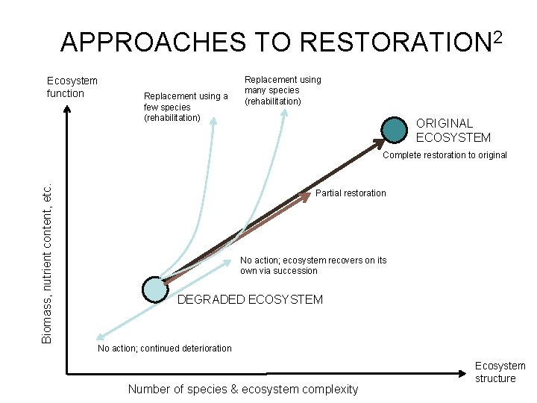
Restoration Graph

Slide 13

Restoration Plan
Ten Steps in a Successful Ecological Restoration:
• Inventory and map
• Describe the site's history
• Develop a hypothesis
• Develop goals
• Develop implementation plan
• Design a monitoring program
• Implement the restoration program.
• Prepare reports and papers
• Periodically evaluate the program
• Communicate with and educate

Slide 14
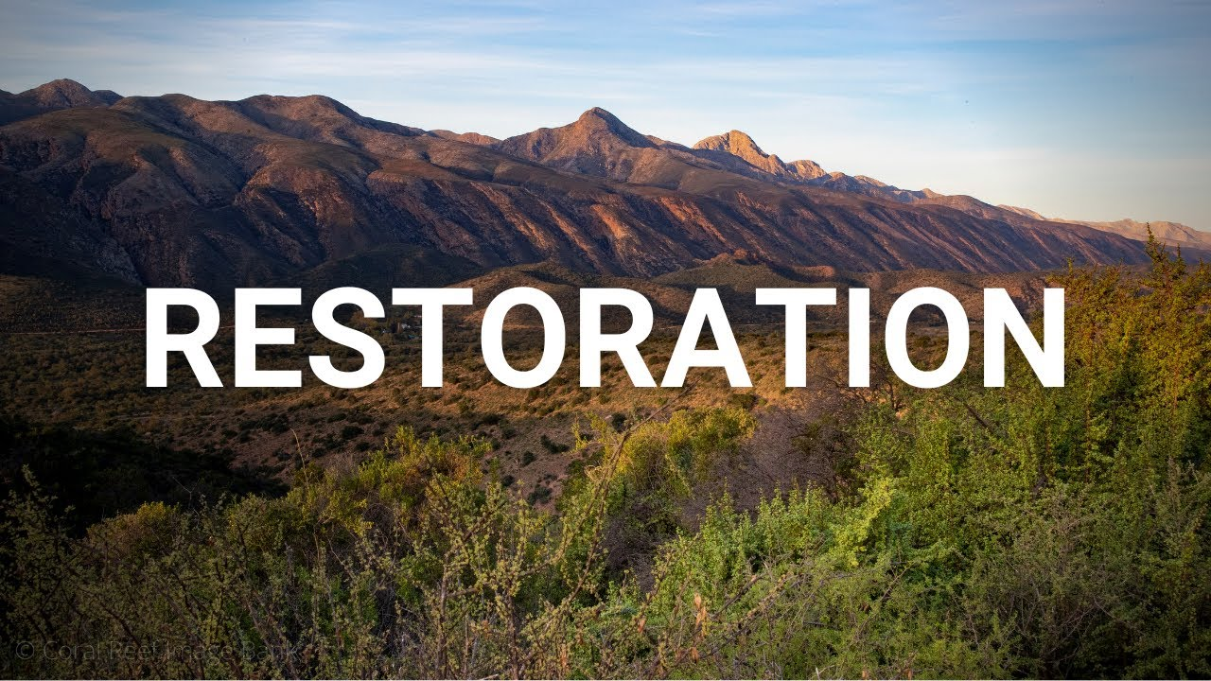
5 R’s Of Restoration Ecology
*Restoration *Rehabilitation
*Remediation *Reclamation
*Re-creation

Slide 15
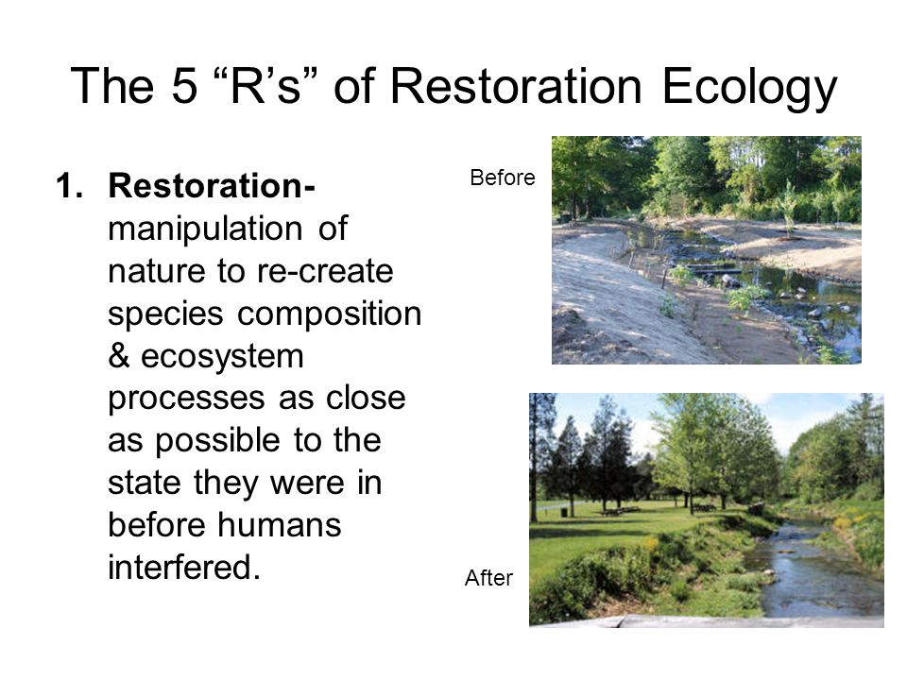

Slide 16
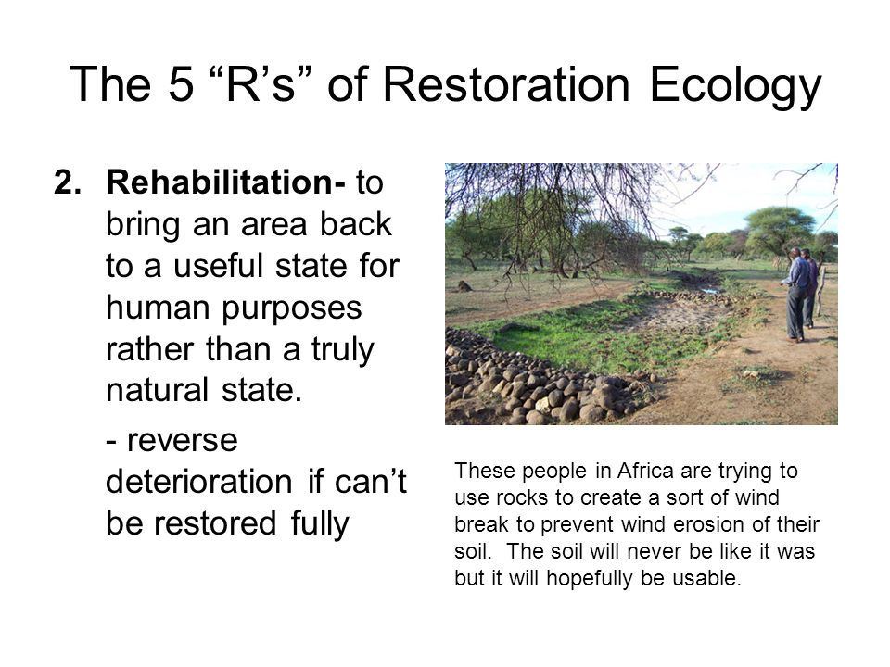

Slide 17
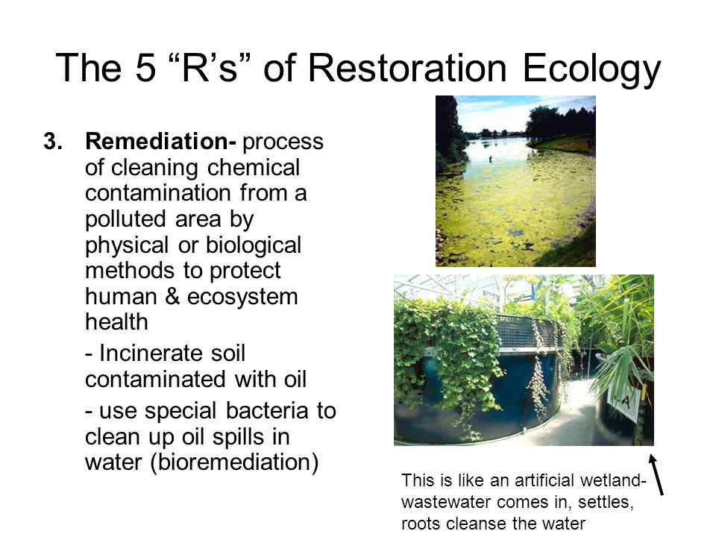

Slide 18
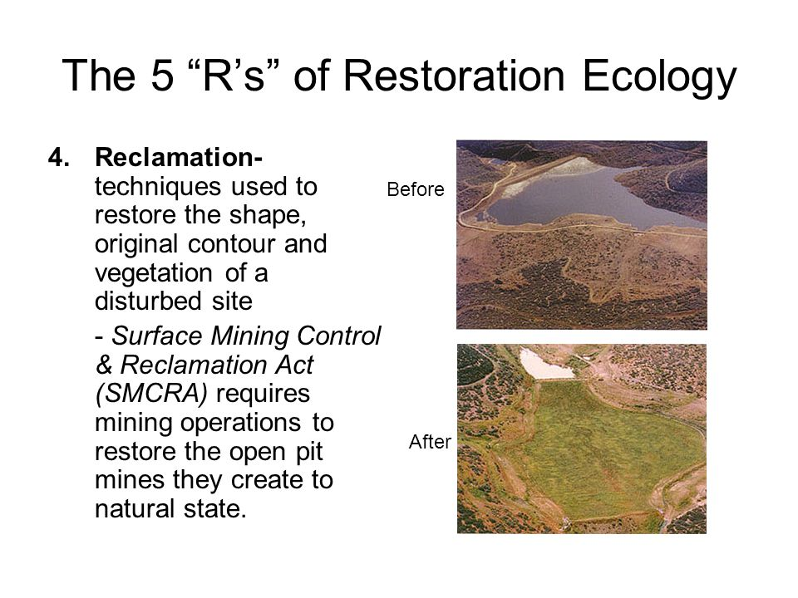

Slide 19
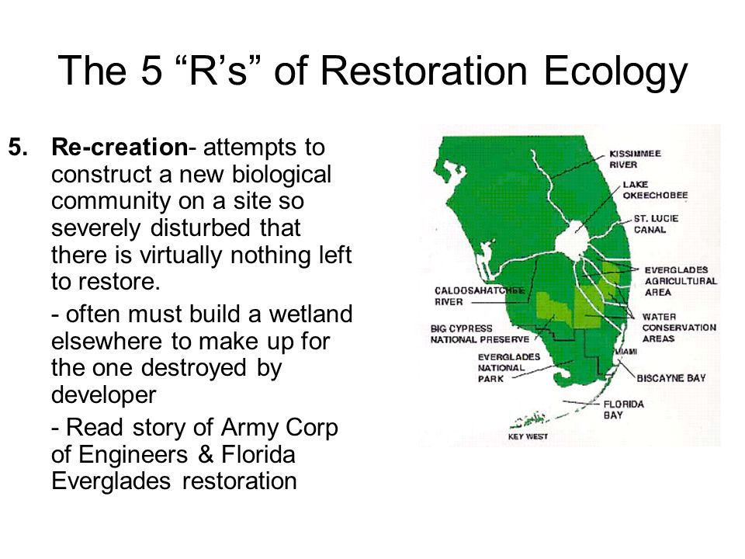

Slide 20


